Slide 1
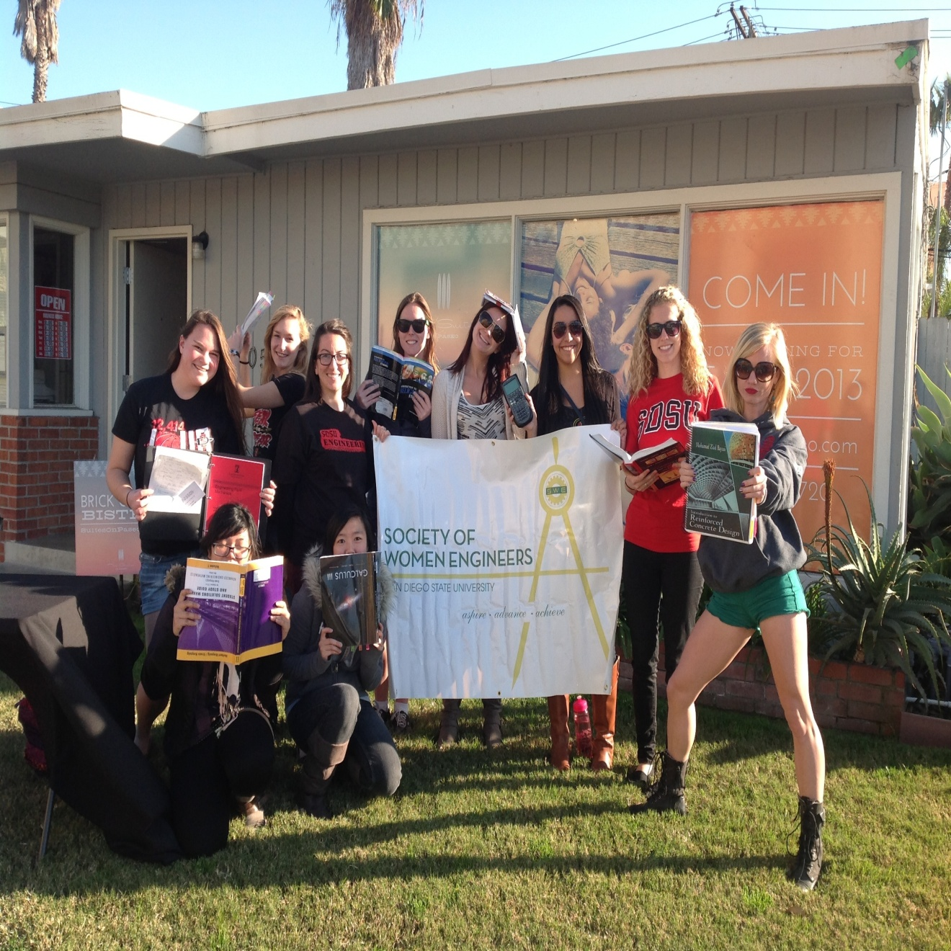
San Diego State University

Slide 2
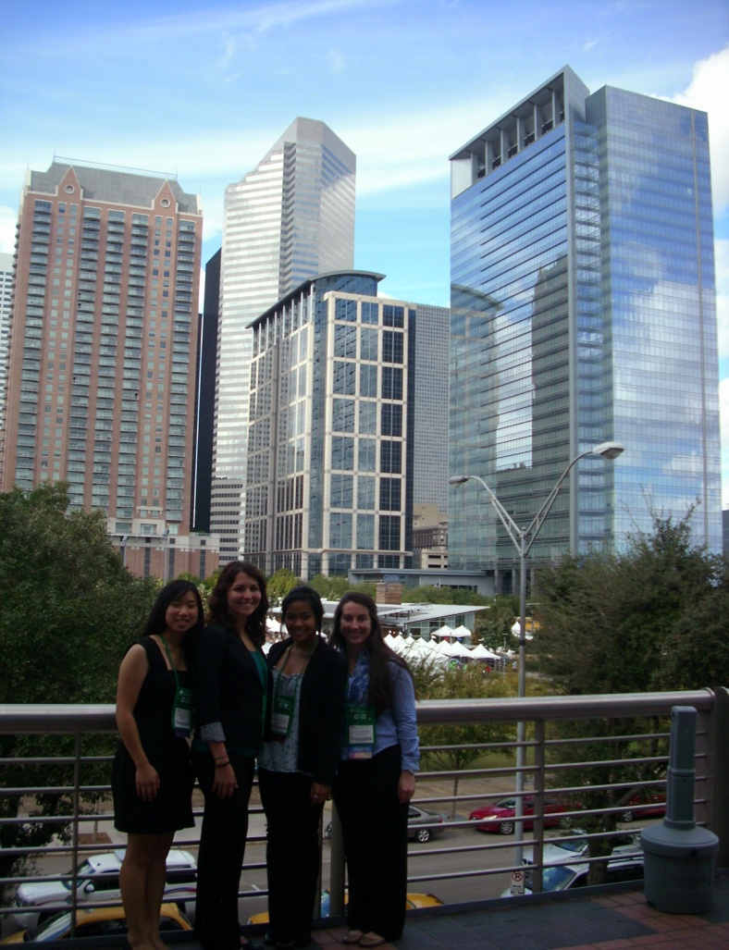
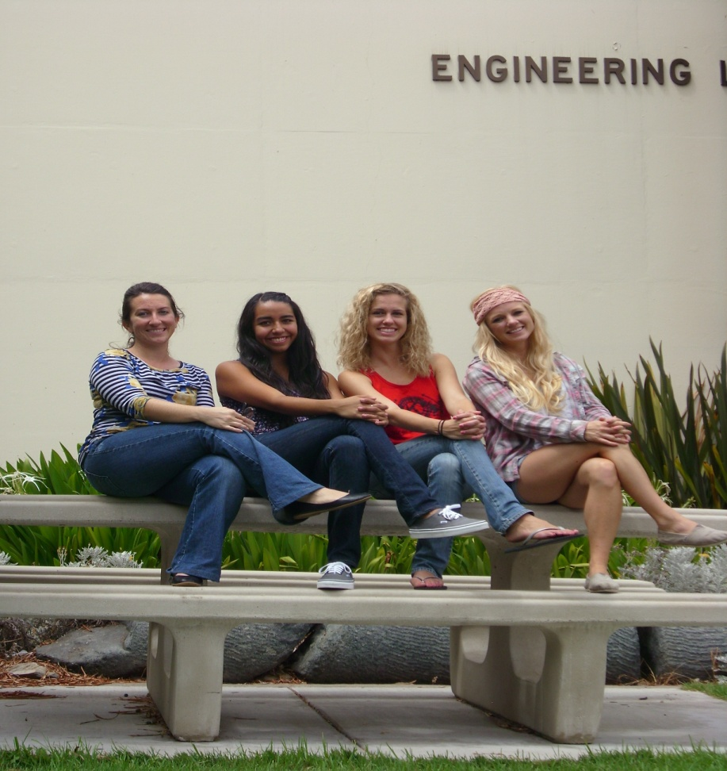
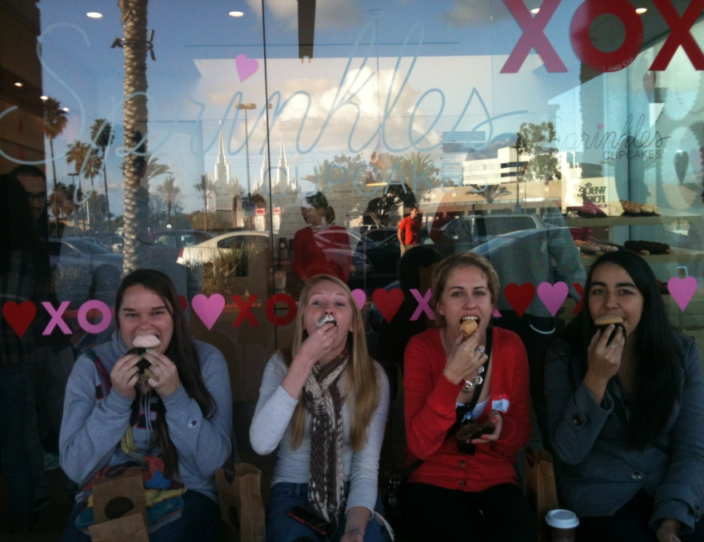
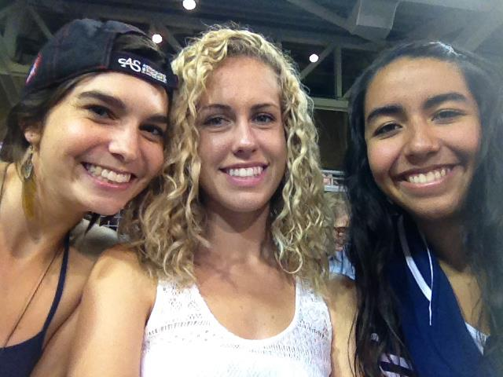
Welcome

Slide 3
How to become a member
Go to www.swe.org
Click on Membership tab
Click on join

Slide 4
Benefits of being a member
Community of Support
Education and Development
Resources and Information
Leadership Skills

Slide 5
College2Career Membership
. Here's a link to the description http://societyofwomenengineers.swe.org/index.php/membership/benefits-a-discounts/409-membership-types/3361-collegiate-membership
$20 a year or $50 for 4 years + 1st professional year
It is a good option for freshmen since it covers all your years of school plus your first year of professional membership.

Slide 6
SWE San Diego Scholarship
Due April 1st
http://www.swesandiego.org/wordpress/wp-content/uploads/FY13_Scholarhips.pdf
http://www.swesandiego.org/fy13-scholarships

Slide 7
Upcoming Events
Thirsty Thursday- March 21st
@ Bridges on El Cajon 8pm-12am
Explore SDSU March 23
Next GBM April 16th @ 3:30 in Aztec Mesa 113
SWEeter Futures

Slide 8
Bring a Friend to a SWE Meeting
If you bring a new friend to a SWE meeting you will be entered into a raffle for a free SWE shirt!
Raffle will be held in April at our GBM

Slide 9
SDSU SWE Scholarship
Active SWE member
2.5 GPA
3 hours of volunteer hours through SWE
3 mandatory SWE meetings
500 word essay
Coming Fall 2013
1-3 scholarships
Awarded in Spring 2014

Slide 10
Elections
Held next week Tuesday, March 26th @ 3:30 Aztec Mesa 113.
If you are interested in running turn in a paragraph on why you are running and how you would be an asset to SWE SDSU.
Positions Available:
(Top 4: President, Vice President, Treasury, Secretary): You may apply if you are already on the EC
Webmaster, Publicity, AESC Rep, Events, Fundraising, Outreach, *Historian, *

Slide 11
Speakers
Northrop Grumman
2 hiring managers
Ken Maney and Michael Fridolfs

Slide 12
Thank you
Questions ??
Contact us at swesdsupresident@gmail.com

